Slide 1

Children’s Diets (Brussels, 1830-1914)
Peter Scholliers

Slide 2
AIM
RELEVANCE & HISTORIOGRAPHY
FOCUS
SOURCES
ASSUMPTIONS
DATA & RESULTS
CONCLUSIONS

Slide 3
AIM:
Considering “second step” of eating (after breastfeeding): children between 2 and 12 years old (i.e., transition from liquid and first solid food to adult’s food)

Slide 4
AIM:
Thesis: children’s diet improved more than adult’s diet in the second half of the 19th century
[based on increasing attention to child-parent relationship, increasing medical specialization with focus on particular groups, and view on ‘social degeneration’ ]

Slide 5
RELEVANCE:
Contribute to children’s diet in the economy
-as producers (industrial revolution)
-as consumers (consumer revolution)
-as “patients” (life expectancy, mortality, height, and other health related issues)

Slide 6
HISTORIOGRAPHY:
Abundant research on institutions (schools, orphanages, hospitals), with stress on policy (finances)
Rare, more general studies of children’s diet (e.g., Anna Davin about poor households in London)

Slide 7
HISTORIOGRAPHY:
Abundant research on institutions (schools, orphanages, hospitals), with stress on policy (finances), e.g. A. McCants (1992), M. Crawford (1994), J. Burnett (1994), A. den Hartog (1994), D. Nourrisson (2004), U. Thoms (2005), R. Westerholt (2007)

Slide 8
HISTORIOGRAPHY: results
Deterioration of children’s diets up to 1850, slow recovery until 1914, and actual improvement after 1920
→ This requires nuancing and more research

Slide 9
FOCUS:
Compare between (attention to) children’s and adults’ diet
Deal with long 19th century (incorporating ‘nutritional revolutions’ – calories/vitamins)
Not based on theoretical treatises, but on practice

Slide 10
FOCUS:
Compare between (attention to) children’s and adults’ diet
Deal with long 19th century (incorporating ‘nutritional revolutions’ – calories/vitamins)
Not based on theoretical treatises, but on practice

Slide 11
FOCUS:
Compare between (attention to) children’s and adults’ diet
Deal with long 19th century (incorporating ‘nutritional revolutions’ – calories/vitamins)
Not based on theoretical treatises, but on practice

Slide 12
SOURCES:
Three key-documents: rules applied at the Brussels general hospitals in 1832, 1859 and 1877 [Régime alimentaire du personnel et des malades des hôpitaux]
A myriad of documents (letters, reports, statistics,…), kept at the hospital archives), 1870s-1910s

Slide 13
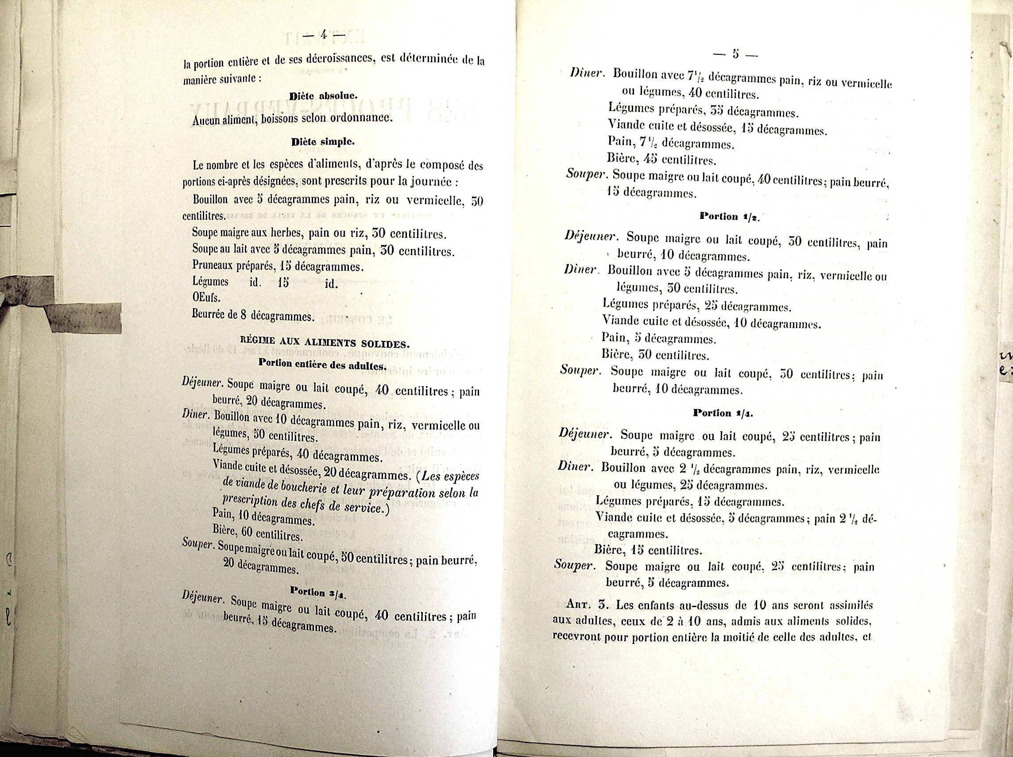
Règlement of 1859 (published in 1861)

Slide 14
Saint-Jean and Saint-Pierre
-established in 13th century
-totally outdated around 1800
-(partly) reconstructed after 1840
-circa 500 beds each (c. 1860)
-since 1803 administered by Conseil général
-treat (most) patients for free
-own bakery and kitchen
-food obtained by public tender

Slide 15
ASSUMPTIONS
Règlements and documents do represent the actual diet in the hospital
Hospital diet mirrors general developments outside the hospital

Slide 16
ASSUMPTIONS
Règlements and documents do represent the actual diet in the hospital (see the continuous, severe controls)
Hospital diet mirrors general developments outside the hospital (financial issues equal those “outside”, and hospitals wished to copy habitual diet)

Slide 17
ASSUMPTIONS
Règlements and documents do represent the actual diet in the hospital (see the continuous, severe controls)
Hospital diet mirrors general developments outside the hospital (financial issues equal those “outside”, and hospitals wished to copy habitual diet) + also question the relationship between “in” and “out”

Slide 18
RESULTS
Three règlements: 1832, 1859, and 1877
Focus on calorie intake
Soft quantitative approach

Slide 19
1832

Slide 22
RESULTS
Three meals in 1832 and 1859, but four in 1877 (goûter was introduced to abolish the habit of hiding food during the day)
Introduction of new foods in 1859: butter (!), rice, vermicelli, coffee (!)
Increase of quantities of bread and vegetables (potatoes)
Higher calorie intake, but lower % of animal products

Slide 23
Daily quantities for ¾ portion for bread, vegetables and meat (g) and beer (cl)

Slide 24
Estimated average intake of calories per person per day, and share of animal calories

Slide 25
Calorie intake (per cent) per meal

Slide 26
Yearly growth in % for the three categories:
 | ¾ | ½ | ¼
1832-1861 | +0.65 | +0.79 | +0.62
1861-1877 | +0.77 | +1.12 | +1.16
1832-1877 | +0.70 | +0,92 | +0.84
% of animal calories
 | 1832 |  |  | 1861 |  |  | 1877
 | ¾ | ½ | ¼ | ¾ | ½ | ¼ | ¾ | ½ | ¼
% animal calories | 30.9 | 33.7 | 30.3 | 27.4 | 24.0 | 27,5 | 31,8 | 25,3 | 25,7

Slide 27
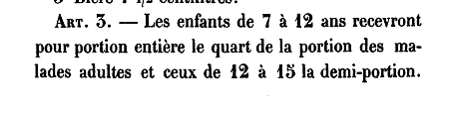
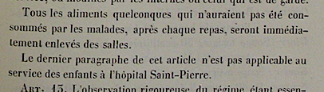
Children ?
1832
1859

Slide 28
Children
Food in “portions” of full diet:
1832: 7 to 12 years: ¼ of full portion
12 to 15 years: ½ of full portion
above 15 years: adult portion

Slide 29
Children
Food in “portions” of full diet:
1832: 7 to 12 years: ¼ of full portion
12 to 15 years: ½ of full portion
above 15 years: adult portion
1859/1877: 2 to 10 years: ½ of full portion
above 10 years = adult portion
+ free to eat outside fixed time (1859)

Slide 30
¾: + 0.70 % ½: + 0.92 % ¼ : + 0.84 %
 | 1832 | 1859 | 1877 | %∆ 1877/1832
7 to 10 years ¼ → ½ | 495 | 1145 | 1400 | +2,33
11 to 12 years ¼ → ¾ | 495 | 1680 | 1930 | +3,07
13 to 14 years ½ → ¾ | 925 | 1680 | 1930 | +1,65

Slide 31
Interpretations:
Overall increase of calorie intake thanks to more bread and potatoes, and introduction of rice and vermicelli
Children
Radical & abrupt change because of
-general improvement of hospital diet
-decision to change children’s classification

Slide 32
1880s – 1914
→ no new Règlement up to 1914
Constant concern about children’s food
→ special dietary reports
→ recommendation to eat “à discrétion”
→daily addition of ¼ litre milk and 2 eggs
→approx. calorie intake of 1,500 kcal/day, obtained by 40% of animal products
→ celebrate of feast of Saint-Nicolas (December 6)

Slide 33
Conclusions
-no specific diet for children (but “portions” of adult diet)
-improvement of children’s diet because of
#general improvement in Brussels hospitals
#specific improvement aimed at children:
.category shift (about which no arguments were found)
.eat “à discrétion”
.additional dairy products

Slide 34
Conclusions
-explanations to be found outside and inside the hospital:
general dietary improvement (particularly after 1850)
specific attention to children “in the air”
-do hospital diets inform about food outside hospital walls?
-if so: children benefited more than adults in the third quarter of the 19th century
-if so: this improvement only made up arrears with regard to the first quarter of the century
-hospitals may have reflected societal changes, but since the 1880s they showed the way in innovations related to children’s food

